Slide 1
Viola-Jones algorithm
Suleimenova Inkara

Slide 2
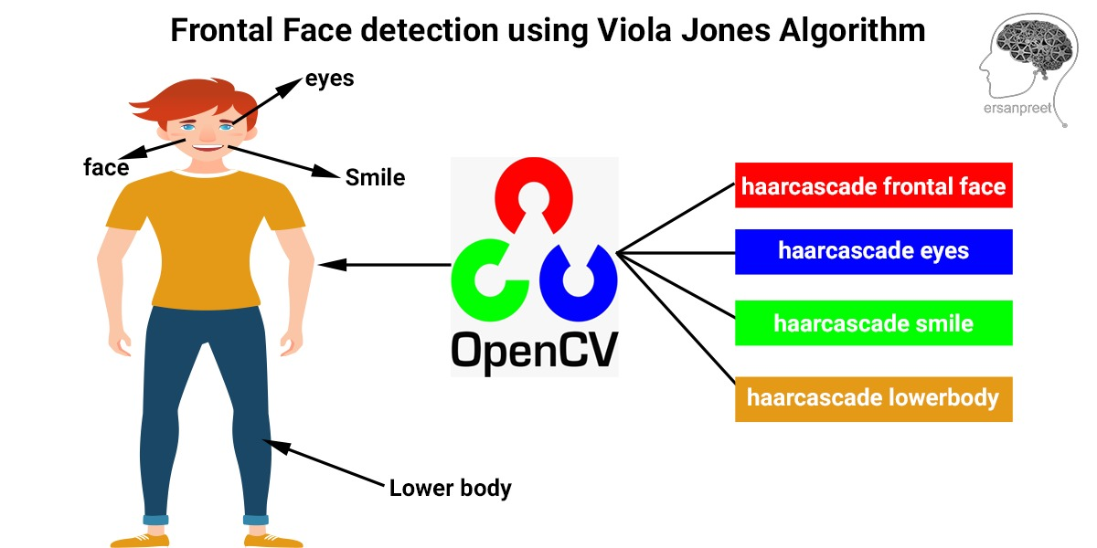
What is Viola Jones algorithm?
Viola Jones algorithm is named after two computer vision researchers who proposed the method in 2001, Paul Viola and Michael Jones in their paper, “Rapid Object Detection using a Boosted Cascade of Simple Features”. Despite being an outdated framework, Viola-Jones is quite powerful, and its application has proven to be exceptionally notable in real-time face detection. This algorithm is painfully slow to train but can detect faces in real-time with impressive speed.
The Viola Jones algorithm has four main steps, which we shall discuss in the sections to follow:
Selecting Haar-like features
Creating an integral image
Running AdaBoost training
Creating classifier cascades

Slide 3
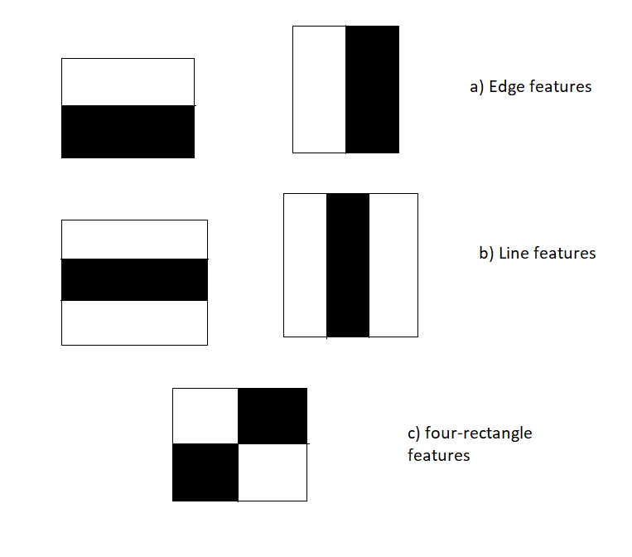
Haar-feature selection
In the 19th century a Hungarian mathematician, Alfred Haar gave the concepts of Haar wavelets, which are a sequence of rescaled “square-shaped” functions which together form a wavelet family or basis. Voila and Jones adapted the idea of using Haar wavelets and developed the so-called Haar-like features.
A Haar-like feature consists of dark regions and light regions. It produces a single value by taking the difference of the sum of the intensities of the dark regions and the sum of the intensities of light regions. It is done to extract useful elements necessary for identifying an object. The features proposed by viola and jones are:

Slide 4
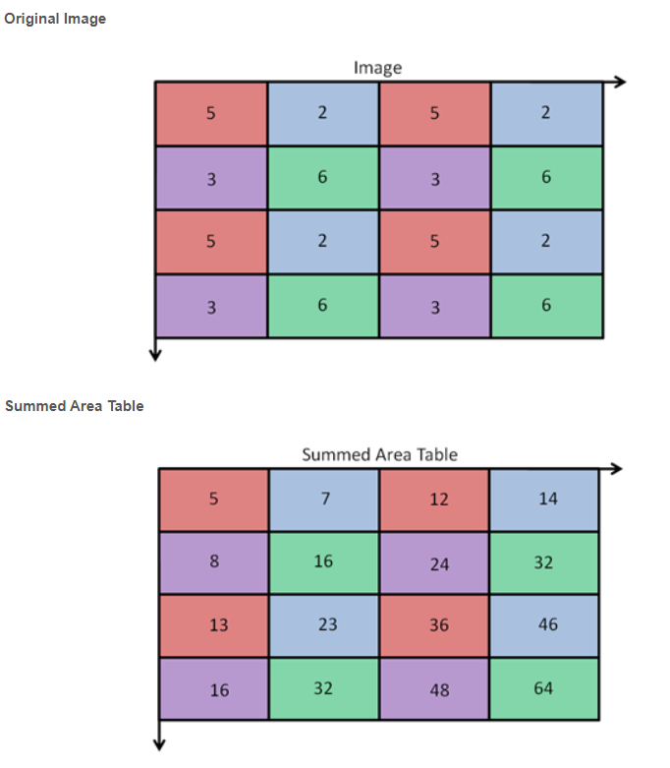
Creation of Integral Images
A given pixel in the integral image is the sum of all the pixels on the left and all the pixels above it. Since the process of extracting Haar-like features involves calculating the difference of dark and light rectangular regions, the introduction of Integral Images reduces the time needed to complete this task significantly.
An integral image gives a fast and simple way to calculate the value of any haar-like feature. This is done by making use of the Summed Area Table. The value for location (x, y) on the integral image is the sum of the pixels above and to the left of the (x, y) on the original image plus itself. For example, from below to calculate the (2,2) = 16: 5+2+3+6 = 16.

Slide 5
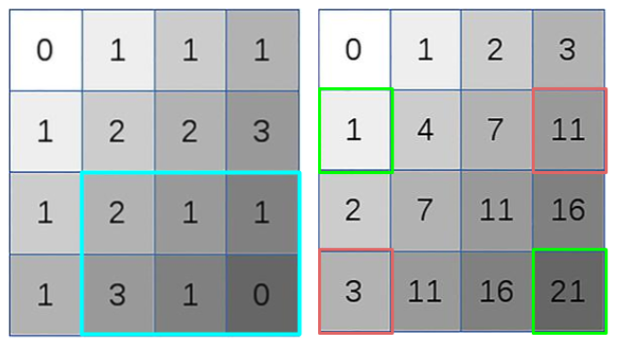
Creation of Integral Images
After constructing the integral image, it is used to efficiently calculate the sum of dark/light rectangular regions in Viola-Jones Algorithm. This is done by summing up (see diagram below) the corner pixels of the wanted window.
To get the sum of the blue rectangle, just add the green values and subtract the red values in the integral image. 1+21–11–3 = 8.

Slide 6
AdaBoost Training
We use a Machine Learning algorithm known as AdaBoost. But why do we even want an algorithm? The number of features that are present in the 24×24 detector window is nearly 160,000, but only a few of these features are important to identify a face. So we use the AdaBoost algorithm to identify the best features in the 160,000 features. In the Viola-Jones algorithm, each Haar-like feature represents a weak learner. To decide the type and size of a feature that goes into the final classifier, AdaBoost checks the performance of all classifiers that you supply to it.
To calculate the performance of a classifier, you evaluate it on all subregions of all the images used for training. Some subregions will produce a strong response in the classifier. Those will be classified as positives, meaning the classifier thinks it contains a human face. Subregions that don’t provide a strong response don’t contain a human face, in the classifiers opinion. They will be classified as negatives. The classifiers that performed well are given higher importance or weight. The final result is a strong classifier, also called a boosted classifier, that contains the best performing weak classifiers.
So when we’re training the AdaBoost to identify important features, we’re feeding it information in the form of training data and subsequently training it to learn from the information to predict. So ultimately, the algorithm is setting a minimum threshold to determine whether something can be classified as a useful feature or not.

Slide 7
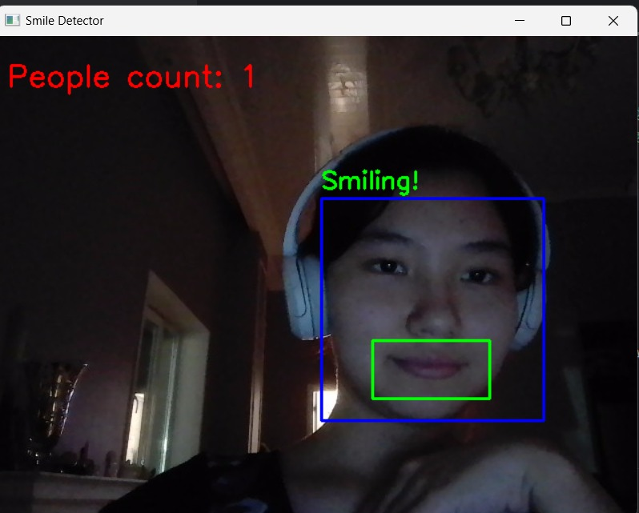
Cascade Classifier
Above it was noted that a strong classifier is made up from many weak classifiers. Here, this strong classifier is turned into a cascade. Having many stages, each stage consists of a weak classifier. By having this chain of stages, it can effectively test our image/subimage. This is since the task of every stage is to determine if in the given window there is not a face or maybe there is a face. The output will always be no or maybe. If ‘no’, the window is discarded and it does not need to go through further levels. If ‘maybe’, the next classifier is called and the process is repeated until the last stage is finished. This is a much more cost effective and a fast procedure since many windows will be quickly discarded.

Slide 8

Stepwise Implementation:
OpenCV comes with lots of pre-trained classifiers. Those XML files can be loaded by cascadeClassifier method of the cv2 module. Here I am going to use haarcascade_frontalface_default.xml, haarcascade_eye.xml, haarcascade_frontalcatface.xml for detecting human faces, cat faces and count them.

Slide 9
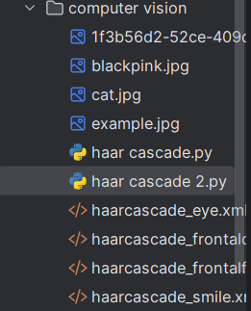
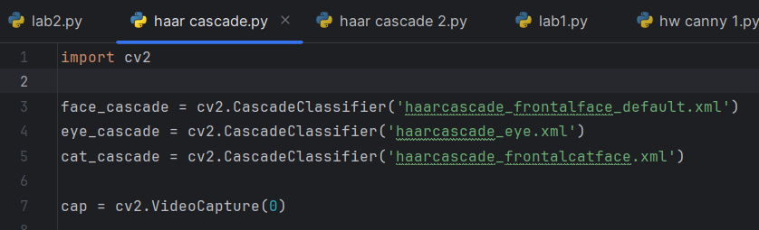
Stepwise Implementation:
1. Import the necessary libraries
2. Loading pre-trained classifiers
3. Opening the Webcam
Creating a cap object that captures video from a webcam (0 means the first camera).

Slide 10
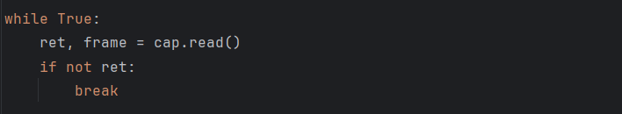
Stepwise Implementation:
4. The main video processing cycle
We run an endless loop to process each frame from the camera.
cap.read() → takes a new frame from the camera.ret → True if the frame was successfully read, otherwise False (for example, if the camera is disabled).break → exit the loop if the image could not be retrieved.

Slide 11
Stepwise Implementation:
5. Detecting Faces and Cats
.detectMultiScale() finds faces/cats in the frame.
Method parameters:
scaleFactor=1.3 — reduces the image by 30% at each scale (helps reduce false positives).
minNeighbors=5 — minimum number of neighboring rectangles required to confirm an object (higher values = fewer false positives).
minSize=(30, 30) — minimum object size to be detected.

Slide 12
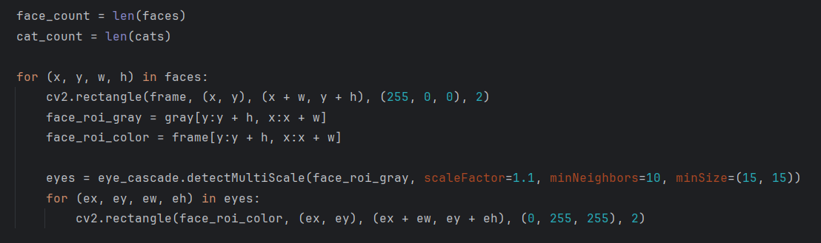
Stepwise Implementation:
6. Counting Objects
Simply counts how many faces and cats were detected.
7. Drawing Rectangles Around Faces
This loop iterates through all detected faces and draws a blue rectangle around them ((255, 0, 0) – blue color)
8. Detecting Eyes Within the Face
We crop the face region to search for eyes only within it.
.detectMultiScale() finds eyes inside the detected face.
If eyes are detected, a yellow rectangle is drawn around them ((0, 255, 255) – yellow color)

Slide 13
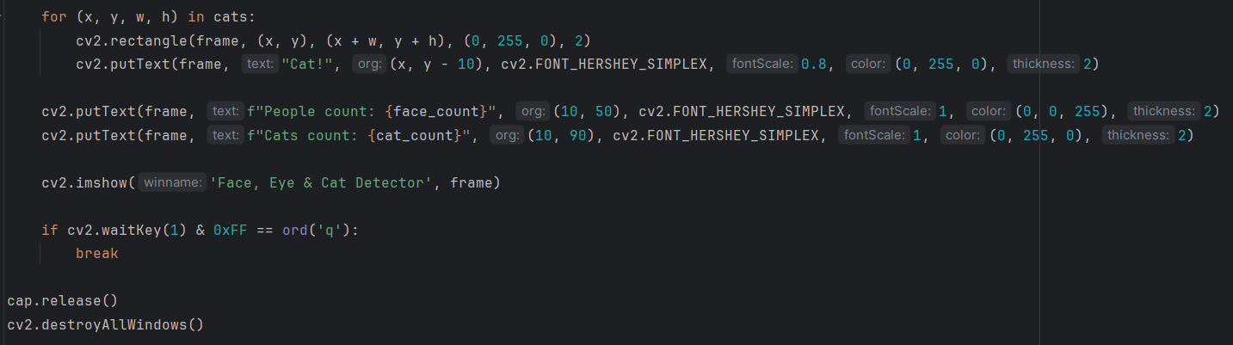
Stepwise Implementation:
9. Drawing Rectangles Around Cats
For each detected cat, a green rectangle is drawn.
The text «Cat!» is displayed above the cat’s head.
10. Displaying the Number of People and Cats
Red text (0, 0, 255) shows the number of people.
Green text (0, 255, 0) shows the number of cats.
11. Displaying the Processed Video
Displays the processed frame in a window.

Slide 14
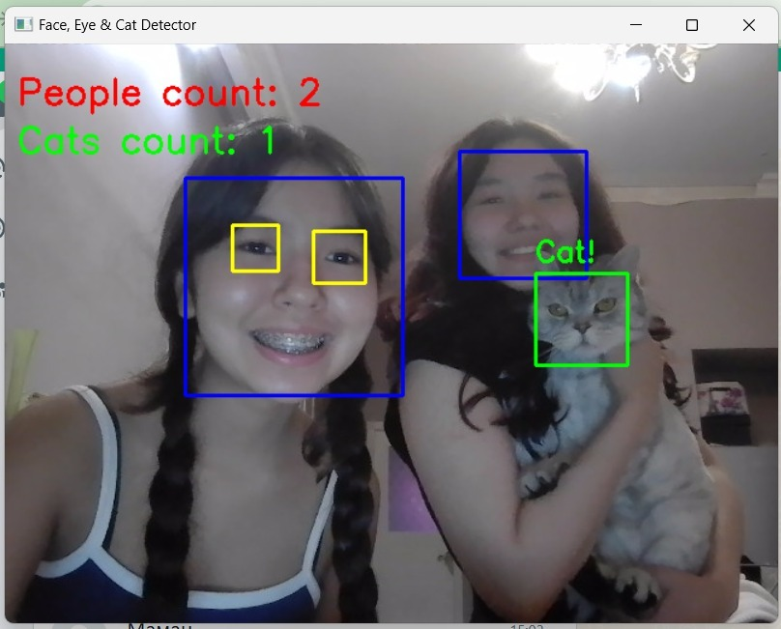
The result

Slide 15

The Viola-Jones algorithm and Haar Cascade classifiers provide a fast and efficient method for object detection, particularly for faces. Their key advantages include high-speed detection, simplicity, and lower data requirements compared to deep learning models. Unlike CNNs, they do not require image rescaling, making them computationally efficient. Additionally, their decision-making process is more interpretable than modern black-box models. However, there are several limitations: training is slow, detection is mostly limited to frontal faces, and the method struggles with extreme lighting conditions. Moreover, it is a binary classification system, meaning it cannot distinguish between multiple object types simultaneously. Despite its drawbacks, the Viola-Jones algorithm remains widely used in applications such as camera viewfinders and social media filters (e.g., Snapchat, Instagram). Its balance between efficiency and simplicity ensures its continued relevance in real-world applications.
Conclusion

Slide 16
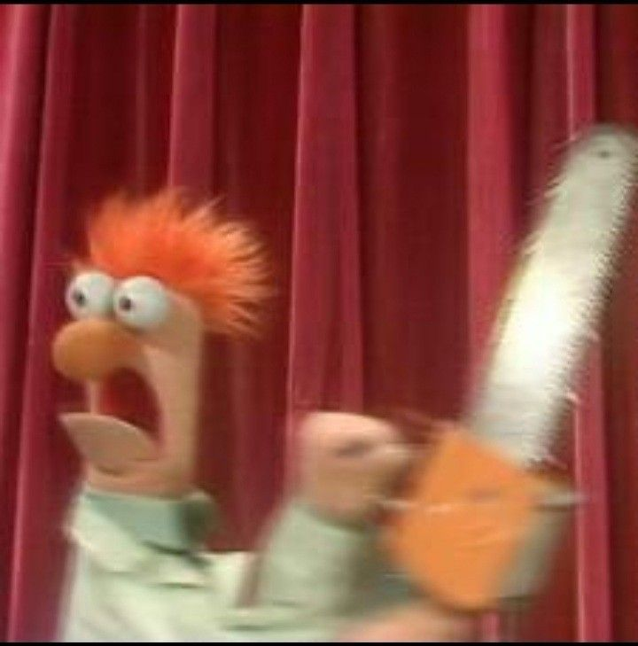
Do you have any questions?
(please don’t ask me anything)

Slide 17

Thank you for attention!

Slide 18
References
Geekforgeeks. Face detection using Cascade Classifier using OpenCV-Python. – URL: https://www.geeksforgeeks.org/face-detection-using-cascade-classifier-using-opencv-python/ (03.10.2023)
Great Learning Editorial Team. Face Detection using Viola Jones Algorithm. – URL: https://www.mygreatlearning.com/blog/viola-jones-algorithm/ (02.09.2024)
Andrew D. Computer Vision: Viola-Jones Object Detection. – URL: https://medium.com/@Andrew_D./computer-vision-viola-jones-object-detection-d2a609527b7c (07.12.2022)
Kamal_DS. Face Detection Using Viola Jones Haar_cascade Classifiers. – URL: https://korlakuntasaikamal10.medium.com/face-detection-using-viola-jones-haar-cascade-classifiers-d514dc3e1709 (21.02.2023)
AaronWard. Facial Detection — Understanding Viola Jones’ Algorithm. – URL: https://medium.com/@aaronward6210/facial-detection-understanding-viola-jones-algorithm-116d1a9db218 (25.01.2020)

